Slide 1
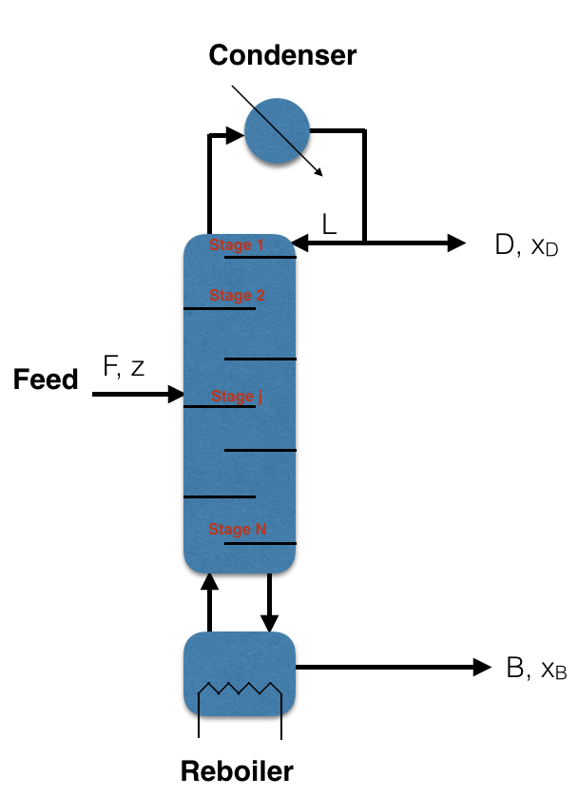








Exercise Problem 1
Calculate D, B, L, V.
Calculate energy input by the condeser
$$F=100mole/hr$$
$$R=1$$
$$Q_{C}$$
$$z=0.5$$
$$Latentheatofvapatcondenser=1500Joule/mole$$
$$x_{B}=0.1$$
$$V$$
$$x_{D}=0.9$$
$$Q_{R}$$

Slide 2
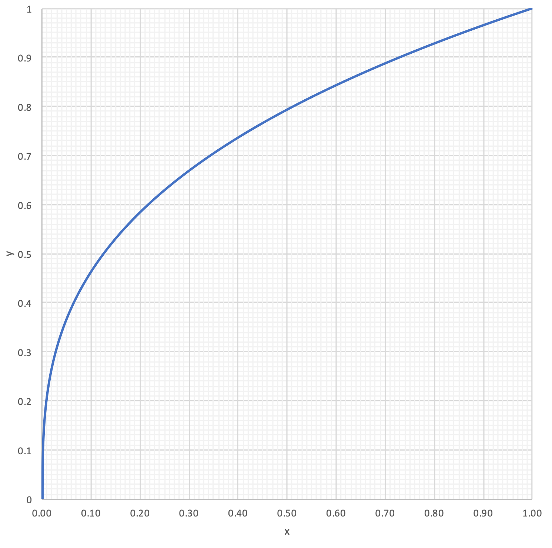
Exercise problem 2:
Calculate number of stages and label composition from the column
xD = 0.8,
xB = 0.2,
z = 0.5,
R = 1,
VB =1.

Slide 3

Exercise problem 3:
Consider the separation of ideal mixture with constant relative volatility of 10. Feed flow rate (z1 = 0.5) is 100 liter/hr and distillate flow rates is 60 liter/hr. Calculate the number of stages to obtain distillate purity of 80% if both reflux and reboiler ratios are 1.

